Slide 1
Helpdesk Tickets Data
How to improve support to fulfill the SLA?
Presented by: Miglena Ruskova

Slide 2
Table of Content
Helpdesk Tickets importance of SLAs
Strengthening IT’s relationship with customers
Formalizing communication
Improving productivity and morale

Slide 3
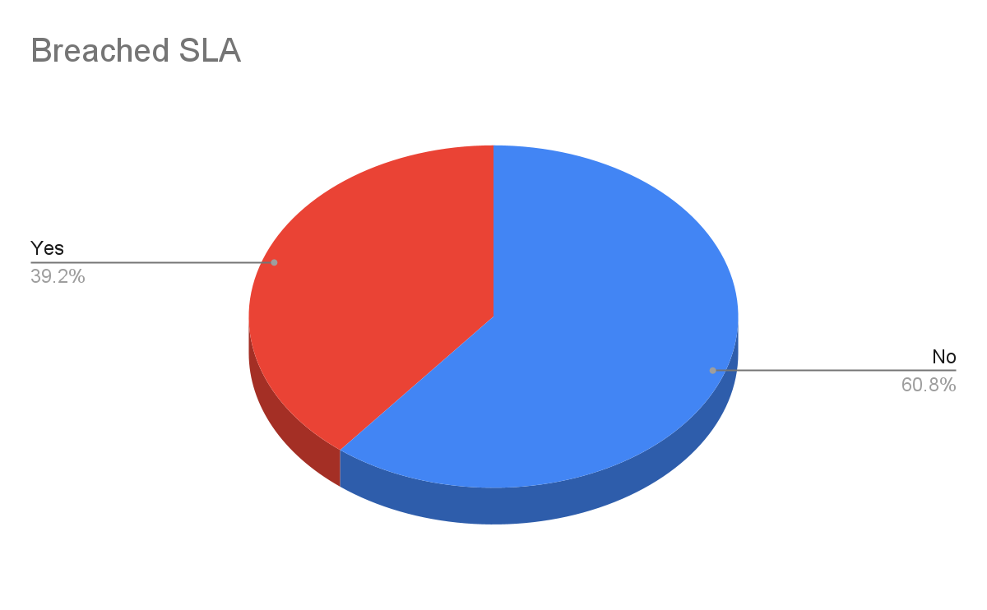
Strengthening IT’s relationship with customers
By defining what happens in the event of a
Breach, they reduce uncertainty.
Breached SLAs in our case are 39.2%. Which is
almost as high as Non Breached SLAs.
In conclusion there is a lot more to improve in
Customers service by the data provided.

Slide 4
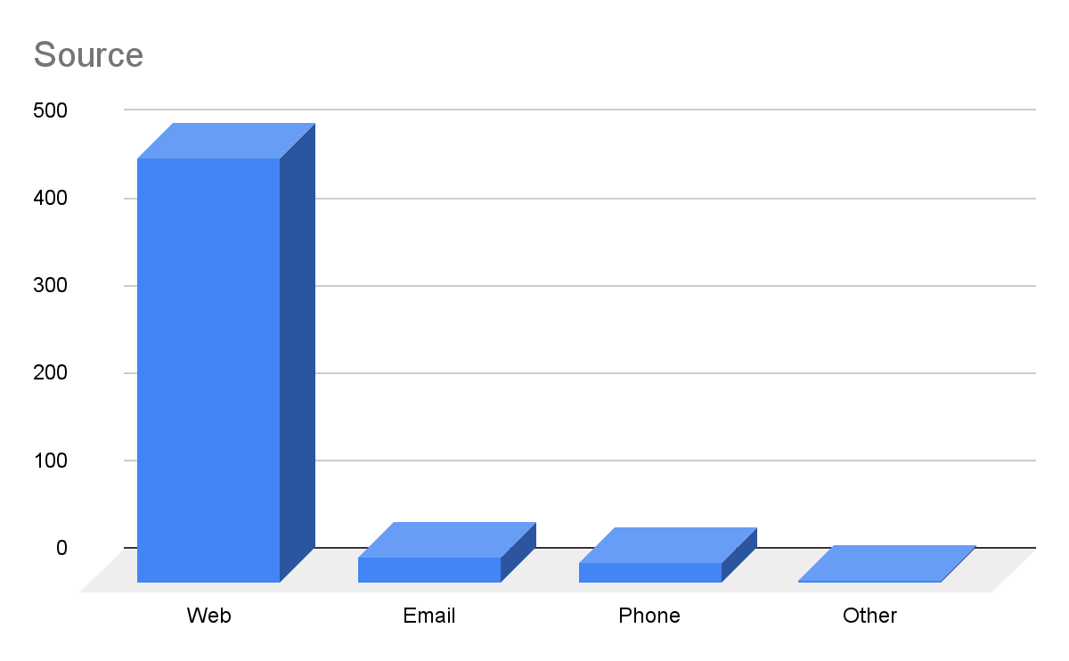
Formalizing communication
An SLA enables stakeholders to have structured conversations based on already agreed-upon teams.
The majority of tickets are coming through the web, so the communication should be focus on the web service.

Slide 5
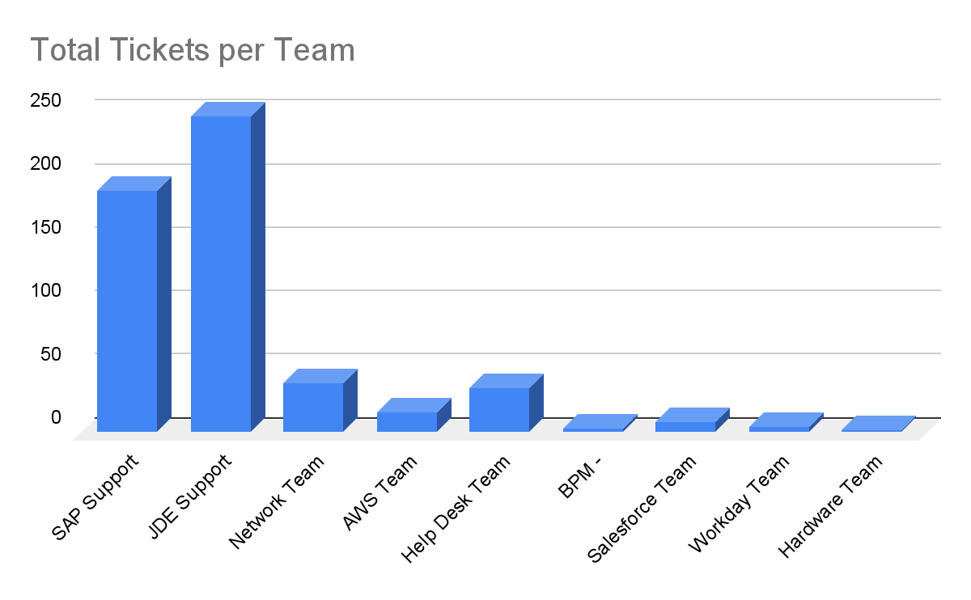
Improving productivity and morale
SLAs define the urgency of incoming requests. They focus IT teams on which incoming issues matter the most.
The majority of tickets are coming through the JDE Support.
In conclusion JDE Support and SAP Support need to improve their services.

Slide 6
Conclusions
1
2
3
According to the data there is a high number of Breached SLAs.
In order to improve the relationship with customers IT Support should work harder to lower Breached SLAs.
The majority of the tickets are coming through the web.
The teams working on the web tickets are doing a great deal and should be supported by the other teams.
JDE Support and SAP Support team are with the highest workload.
In order to avoid more Breached SLAs those two teams should be well looked after by the management!

